Slide 1
Single-phase Fluid Finite-difference Simulator using Python
Benyamin Manullang (12211081)
Thesis advisor: Zuher Syihab, Ph.D.
Bandung, 21 June 2016

Slide 2
Outline
Preface
Introduction
Research objectives
Research methodology
Statements of Theory
Diffusivity equation
Finite-difference Method
Python (programming language) and SciPy stack
Implementation
Designing the Data Structures
Applying Finite-difference Method
Running a simulation
Data visualization
Examples (Four examples)
Concluding Remarks
Recommendations

Slide 3
1.a Introduction
Often, many undergraduate students fail to understand how a reservoir simulator works behind the monitor.
True story. I interned (kerja praktek) at some oil company. And one reservoir simulation engineer did not even realize he/she declared a keyword in 1970, while the field had been producing since 1930.
I could only wonder if this small inconsistency had happened in other model.
This paper implements finite-difference method in the form of Python code.

Slide 4
1.b Research objectives
To produce Python code as an implementation of finite-difference method in solving a single-phase, slightly-compressible, black-oil fluid flow problem
To verify the results of simulation examples obtained using this simulator

Slide 5
1.c Research methodology
Problem definition
Setting up few examples
Literature review
Verify the results
Specify tools
Conclusion
Implementation

Slide 6
Outline
Preface
Introduction
Research objectives
Research methodology
Statements of Theory
Diffusivity equation
Finite-difference Method
Python (programming language) and SciPy stack
Implementation
Designing the Data Structures
Applying Finite-difference Method
Running a simulation
Data visualization
Examples (Four examples)
Concluding Remarks
Recommendations

Slide 7
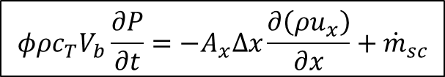
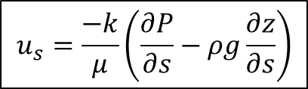
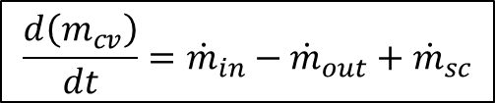
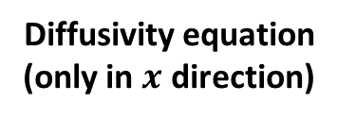
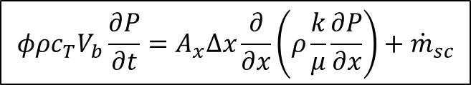
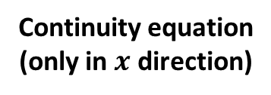
2.a Diffusivity equation
In the field of reservoir engineering, diffusivity equation is Darcy’s law derived on the basis of conservation of mass.
Conservation of mass
$$\frac{d\left(m_{cv}\right)}{dt}={\dot{m}}_{in}−{\dot{m}}_{out}+{\dot{m}}_{sc}$$
Continuity equation
(only in $x$ direction)
$$φρc_{T}V_{b}\frac{∂P}{∂t}=−A_{x}Δx\frac{∂\left(ρu_{x}\right)}{∂x}+{\dot{m}}_{sc}$$
Darcy’s law
$$u_{s}=\frac{−k}{μ}\left(\frac{∂P}{∂s}−ρg\frac{∂z}{∂s}\right)$$
$$φρc_{T}V_{b}\frac{∂P}{∂t}=A_{x}Δx\frac{∂}{∂x}\left(ρ\frac{k}{μ}\frac{∂P}{∂x}\right)+{\dot{m}}_{sc}$$
Diffusivity equation
(only in $x$ direction)

Slide 8
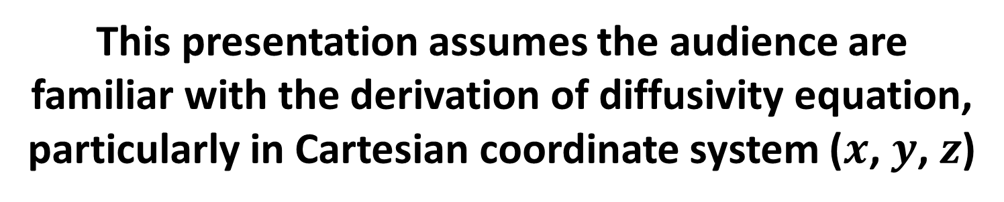
This presentation assumes the audience are
familiar with the derivation of diffusivity equation,
particularly in Cartesian coordinate system ($x$, $y$, $z$)
$$φρc_{T}V_{b}\frac{∂P}{∂t}=A_{x}Δx\frac{∂}{∂x}\left(ρ\frac{k}{μ}\frac{∂P}{∂x}\right)+A_{y}Δy\frac{∂}{∂y}\left(ρ\frac{k}{μ}\frac{∂P}{∂y}\right)+A_{z}Δz\frac{∂}{∂z}\left(ρ\frac{k}{μ}\left[\frac{∂P}{∂z}−ρg\right]\right)+{\dot{m}}_{sc}$$

Slide 9



2.b Finite-difference Method
Finite-difference is a numerical method for solving differential equations by approximating them with difference equations.
Instead of this differential equation,
we use this difference equation.
$$\begin{matrix}\frac{df}{dx} & =\lim_{Δx→0}{\frac{f\left(x+Δx\right)−f\left(x\right)}{\left(x+Δx\right)−\left(x\right)}} \\ & =\lim_{Δx→0}{\frac{Δf\left(x\right)}{Δx}}\end{matrix}$$
$$\frac{df}{dx}≈\frac{f_{x+h}−f_{x}}{h}$$
or
$$\frac{df}{dx}≈\frac{f_{x+\frac{1}{2}h}−f_{x−\frac{1}{2}h}}{h}$$

Slide 10
2.c Python (programming language) and SciPy stack
Python is a programming language designed by Guido van Rossum in 1991.
It is neat and simple, compared to other programming languages.

Slide 11
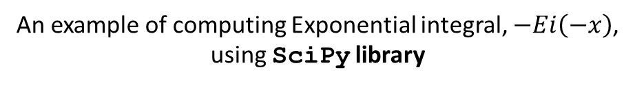
2.c Python (programming language) and SciPy stack
SciPy stack is a Python-based ecosystem of open-source software for mathematics, science, and engineering.
Two of the core packages which are used are NumPy and SciPy library.
An example of computing Exponential integral, $−Ei\left(−x\right)$,
using SciPy library
In [1]: import scipy
In [2]: -scipy.special.expi(-0.02)
Out[2]: 3.3547077833097094

Slide 12
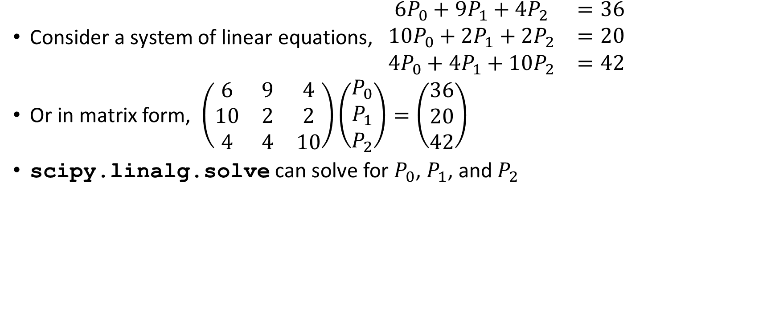
2.c Python (programming language) and SciPy stack
Consider a system of linear equations, $\begin{matrix}6P_{0}+9P_{1}+4P_{2} & =36 \\ 10P_{0}+2P_{1}+2P_{2} & =20 \\ 4P_{0}+4P_{1}+10P_{2} & =42\end{matrix}$
Or in matrix form, $\left(\begin{matrix}6 & 9 & 4 \\ 10 & 2 & 2 \\ 4 & 4 & 10\end{matrix}\right)\left(\begin{matrix}P_{0} \\ P_{1} \\ P_{2}\end{matrix}\right)=\left(\begin{matrix}36 \\ 20 \\ 42\end{matrix}\right)$
scipy.linalg.solve can solve for $P_{0}$, $P_{1}$, and $P_{2}$
In [1]: import scipy
In [2]: coeffMatrix = [[6, 9, 4],
[10, 2, 2],
[4, 4, 10]]
In [3]: rhs = [36, 20, 42]
In [4]: results = scipy.linalg.solve(coeffMatrix, rhs)
In [5]: print(results)
Out[5]: [ 1. 2. 3.]

Slide 13
Outline
Preface
Introduction
Research objectives
Research methodology
Statements of Theory
Diffusivity equation
Finite-difference Method
Python (programming language) and SciPy stack
Implementation
Applying Finite-difference Method
Designing the Data Structures
Running a simulation
Data visualization
Examples (Four examples)
Concluding Remarks
Recommendations

Slide 14
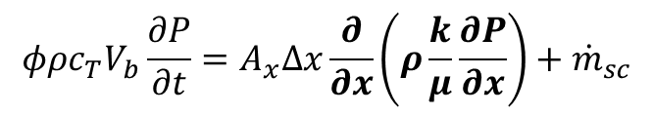
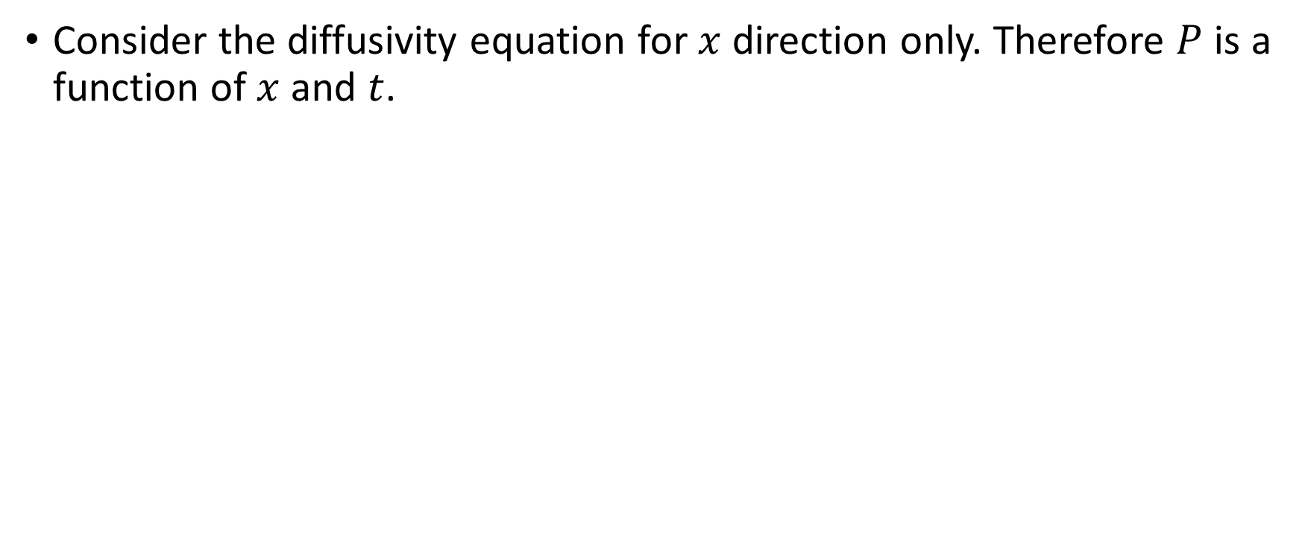

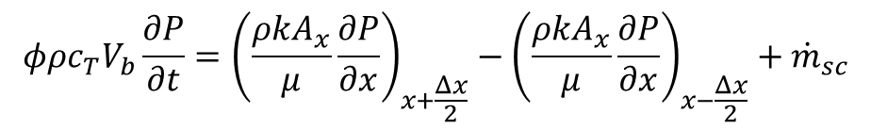
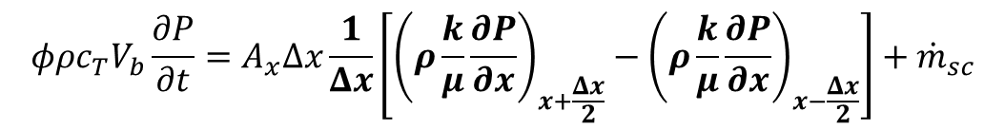
3.a Applying the Finite-difference Method
Consider the diffusivity equation for $x$ direction only. Therefore $P$ is a function of $x$ and $t$.
$$φρc_{T}V_{b}\frac{∂P}{∂t}=A_{x}Δx\frac{∂}{∂x}\left(ρ\frac{k}{μ}\frac{∂P}{∂x}\right)+{\dot{m}}_{sc}$$
Apply finite-difference w.r.t. $x$
$$φρc_{T}V_{b}\frac{∂P}{∂t}=A_{x}Δx\frac{1}{Δx}\left[{\left(ρ\frac{k}{μ}\frac{∂P}{∂x}\right)}_{x+\frac{Δx}{2}}−{\left(ρ\frac{k}{μ}\frac{∂P}{∂x}\right)}_{x−\frac{Δx}{2}}\right]+{\dot{m}}_{sc}$$
$$φρc_{T}V_{b}\frac{∂P}{∂t}={\left(\frac{ρkA_{x}}{μ}\frac{∂P}{∂x}\right)}_{x+\frac{Δx}{2}}−{\left(\frac{ρkA_{x}}{μ}\frac{∂P}{∂x}\right)}_{x−\frac{Δx}{2}}+{\dot{m}}_{sc}$$

Slide 15
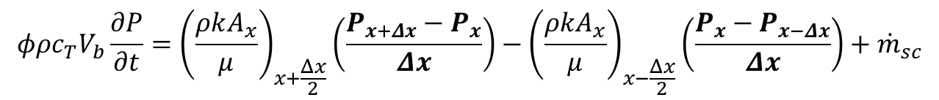
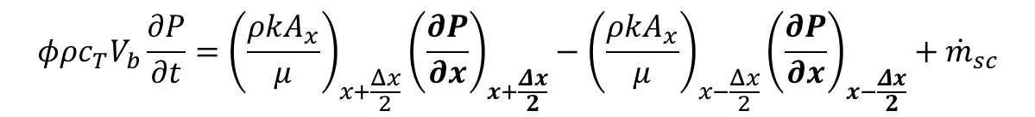
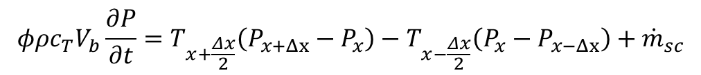

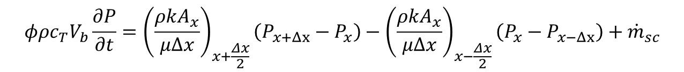
$$φρc_{T}V_{b}\frac{∂P}{∂t}={\left(\frac{ρkA_{x}}{μ}\right)}_{x+\frac{Δx}{2}}{\left(\frac{∂P}{∂x}\right)}_{x+\frac{Δx}{2}}−{\left(\frac{ρkA_{x}}{μ}\right)}_{x−\frac{Δx}{2}}{\left(\frac{∂P}{∂x}\right)}_{x−\frac{Δx}{2}}+{\dot{m}}_{sc}$$
$$φρc_{T}V_{b}\frac{∂P}{∂t}={\left(\frac{ρkA_{x}}{μ}\right)}_{x+\frac{Δx}{2}}\left(\frac{P_{x+Δx}−P_{x}}{Δx}\right)−{\left(\frac{ρkA_{x}}{μ}\right)}_{x−\frac{Δx}{2}}\left(\frac{P_{x}−P_{x−Δx}}{Δx}\right)+{\dot{m}}_{sc}$$
$$φρc_{T}V_{b}\frac{∂P}{∂t}={\left(\frac{ρkA_{x}}{μΔx}\right)}_{x+\frac{Δx}{2}}\left(P_{x+Δx}−P_{x}\right)−{\left(\frac{ρkA_{x}}{μΔx}\right)}_{x−\frac{Δx}{2}}\left(P_{x}−P_{x−Δx}\right)+{\dot{m}}_{sc}$$
define transmissibility, $T=\frac{ρkA_{x}}{μΔx}$
$$φρc_{T}V_{b}\frac{∂P}{∂t}=T_{x+\frac{Δx}{2}}\left(P_{x+Δx}−P_{x}\right)−T_{x−\frac{Δx}{2}}\left(P_{x}−P_{x−Δx}\right)+{\dot{m}}_{sc}$$

Slide 16

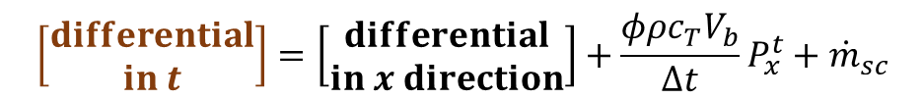
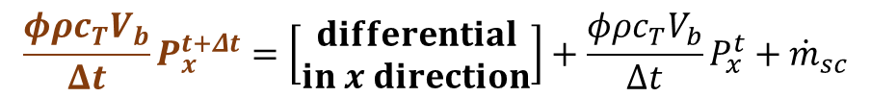
$$φρc_{T}V_{b}\frac{∂P}{∂t}=T_{x+\frac{Δx}{2}}P_{x+Δx}−\left(T_{x+\frac{Δx}{2}}+T_{x−\frac{Δx}{2}}\right)P_{x}+T_{x−\frac{Δx}{2}}P_{x−Δx}+{\dot{m}}_{sc}$$
Apply finite-difference w.r.t. $t$
$$φρc_{T}V_{b}\frac{\left(P_{x}^{t+Δt}−P_{x}^{t}\right)}{Δt}=T_{x+\frac{Δx}{2}}P_{x+Δx}−\left(T_{x+\frac{Δx}{2}}+T_{x−\frac{Δx}{2}}\right)P_{x}+T_{x−\frac{Δx}{2}}P_{x−Δx}+{\dot{m}}_{sc}$$
$$\frac{φρc_{T}V_{b}}{Δt}\left(P_{x}^{t+Δt}−P_{x}^{t}\right)=T_{x+\frac{Δx}{2}}^{t}P_{x+Δx}^{t+Δt}−\left(T_{x+\frac{Δx}{2}}^{t}+T_{x−\frac{Δx}{2}}^{t}\right)P_{x}^{t+Δt}+T_{x−\frac{Δx}{2}}^{t}P_{x−Δx}^{t+Δt}+{\dot{m}}_{sc}$$
$$\frac{φρc_{T}V_{b}}{Δt}P_{x}^{t+Δt}=\left[\begin{matrix}differential \\ in x direction\end{matrix}\right]+\frac{φρc_{T}V_{b}}{Δt}P_{x}^{t}+{\dot{m}}_{sc}$$
$$\left[\begin{matrix}differential \\ in t\end{matrix}\right]=\left[\begin{matrix}differential \\ in x direction\end{matrix}\right]+\frac{φρc_{T}V_{b}}{Δt}P_{x}^{t}+{\dot{m}}_{sc}$$

Slide 17
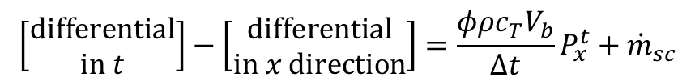
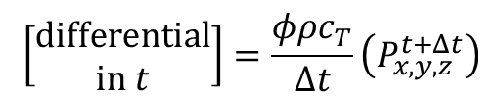
$$\left[\begin{matrix}differential \\ in t\end{matrix}\right]−\left[\begin{matrix}differential \\ in x direction\end{matrix}\right]=\frac{φρc_{T}V_{b}}{Δt}P_{x}^{t}+{\dot{m}}_{sc}$$
where:
$$\left[\begin{matrix}differential \\ in t\end{matrix}\right]=\frac{φρc_{T}}{Δt}\left(P_{x,y,z}^{t+Δt}\right)$$
$$\left[\begin{matrix}differential \\ in x direction\end{matrix}\right]=T_{x+\frac{Δx}{2}}^{t}P_{x+Δx}^{t+Δt}−\left(T_{x+\frac{Δx}{2}}^{t}+T_{x−\frac{Δx}{2}}^{t}\right)P_{x}^{t+Δt}+T_{x−\frac{Δx}{2}}^{t}P_{x−Δx}^{t+Δt}$$

Slide 18

3.a Applying the Finite-difference Method (cont’d)
Using the same procedure, we can further generalize that form into
$$\left[\begin{matrix}differential \\ in t\end{matrix}\right]−\left[\begin{matrix}differential \\ in x direction\end{matrix}\right]−\left[\begin{matrix}differential \\ in y direction\end{matrix}\right]−\left[\begin{matrix}differential \\ in z direction\end{matrix}\right]=\frac{φρc_{T}}{Δt}P_{x,y,z}^{t}+\left(−T_{z+\frac{Δz}{2}}+T_{z−\frac{Δz}{2}}\right)ρgΔz+{\dot{m}}_{sc}$$
where:
$$\begin{matrix}\begin{matrix}differential \\ in x direction\end{matrix} & =T_{x+\frac{Δx}{2}}^{t}P_{x+Δx}^{t+Δt}−\left(T_{x+\frac{Δx}{2}}^{t}+T_{x−\frac{Δx}{2}}^{t}\right)P_{x}^{t+Δt}+T_{x−\frac{Δx}{2}}^{t}P_{x−Δx}^{t+Δt} \\ \begin{matrix}differential \\ in y direction\end{matrix} & =T_{y+\frac{Δy}{2}}^{t}P_{y+Δy}^{t+Δt}−\left(T_{y+\frac{Δy}{2}}^{t}+T_{y−\frac{Δy}{2}}^{t}\right)P_{y}^{t+Δt}+T_{y−\frac{Δy}{2}}^{t}P_{y−Δy}^{t+Δt} \\ \begin{matrix}differential \\ in z direction\end{matrix} & =T_{z+\frac{Δz}{2}}^{t}P_{z+Δz}^{t+Δt}−\left(T_{z+\frac{Δz}{2}}^{t}+T_{z−\frac{Δz}{2}}^{t}\right)P_{z}^{t+Δt}+T_{z−\frac{Δz}{2}}^{t}P_{z−Δz}^{t+Δt} \\ & \\ \begin{matrix}differential \\ in t\end{matrix} & =\frac{φρc_{T}}{Δt}\left(P_{x,y,z}^{t+Δt}\right)\end{matrix}$$

Slide 19
3.b Designing the Data Structures
In computer science, a data structure is a particular way of organizing data in a computer
How do we represent the behavior of a reservoir system (consisting of fluid and rock) in a 3D Cartesian space?

Slide 20
Reservoir
contains
contains
contains
Grid
contains
Fluid
Rock
Node
(optional) assigned to
BoundaryCondition

Slide 21
3.b Designing the Data Structures (Node and Grid classes)
# Firstly, we can specify the dimension of the cartesian grid
nz, ny, nx = 1, 1, 5
dims = (nz, ny, nx)
g = Grid(dims)
# This will instantiate five Node objects (nz*ny*nx)

Slide 22

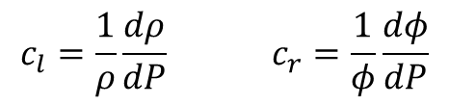
3.b Designing the Data Structures (Fluid and Rock classes)
f = Fluid(refRho=62.428, refPres=14.7, compress=3.5*1e-6, mu=10)
r = Rock(refPoro=0.18, refPres=14.7, compress=0, perm=0.015)
In [1]: f.getRho(6000)
Out[1]: 63.749570239861526
We will only consider slightly-compressible fluid.
$$\begin{matrix}c_{l}=\frac{1}{ρ}\frac{dρ}{dP} & & c_{r}=\frac{1}{φ}\frac{dφ}{dP}\end{matrix}$$
$$\begin{matrix}ρ=ρ_{0}e^{c_{l}\left(P−P_{0}\right)} & & φ=φ_{0}e^{c_{r}\left(P−P_{0}\right)}\end{matrix}$$

Slide 23
3.b Designing the Data Structures (Reservoir class)
# Specify the whole reservoir dimension
Lz, Ly, Lx = 75, 1000, 5000
resDimension = (Lz, Ly, Lx)
# We contain all information in a Reservoir object
res = Reservoir(grid=g, fluid=f, rock=r, resDim=resDimension)
# Set the initial pressure array
res.setInitPressure(6000)
In [1]: res.grid.deltaX
Out[1]: 1000
In [2]: res.resDim
Out[2]: (75, 1000, 5000)
In [3]: res.grid.numOfNodes
Out[3]: 5

Slide 24
3.c Running a simulation
# Set a source/sink in coordinate (0, 0, 3)
res.grid.nodes[3].setSrc(-150)
# Finally, run the simulation!
runSimulation(res, dt=15, nTime=24)
In [1]: runfile(‘example-1.py')
Out[1]: Evaluating t=0
presBefore = [[[ 6000. 6000. 6000. 6000. 6000.]]]
Evaluating t=1
presBefore = [[[ 5999.08255089 5995.02322252 5968.94373667 5805.45328299
5964.13608728]]]
Evaluating t=2
......

Slide 25
3.c Running a simulation (cont’d)
A results.txt file will be generated
6000.0000 6000.0000 6000.0000 6000.0000 6000.0000
5999.0826 5995.0232 5968.9437 5805.4533 5964.1361
5996.2893 5983.9301 5922.4857 5655.4046 5907.2356
5990.9090 5967.1030 5868.8328 5533.0038 5838.2722
5982.5189 5945.3945 5812.1946 5428.1457 5762.7000
5970.9368 5919.6877 5754.6549 5334.7122 5683.8398
5956.1539 5890.7401 5697.1837 5248.9565 5603.7107
5938.2736 5859.1516 5640.1807 5168.5510 5523.5314
time level 0
time level 1
time level 2

Slide 26
3.d Data visualization
Microsoft Excel® is sufficient to plot a 1D pressure distribution data
For 2D or 3D pressure distribution at a time level. We will use MRST’s plotCellData function (not my code!)
MRST is a MATLAB-based reservoir simulator developed by a group of researchers (SINTEF ICT) in Norway

Slide 27
Outline
Preface
Introduction
Research objectives
Research methodology
Statements of Theory
Diffusivity equation
Finite-difference Method
Python (programming language) and Scipy stack
Implementation
Designing the Data Structures
Applying Finite-difference Method
Running a simulation
Data visualization
Examples (Four examples)
Concluding Remarks
Recommendations

Slide 28
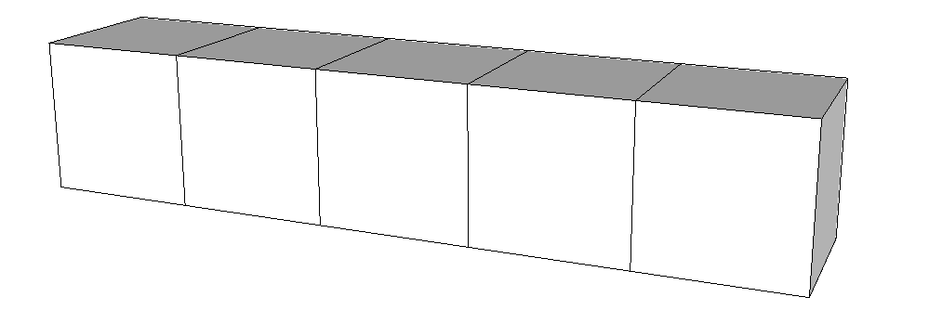

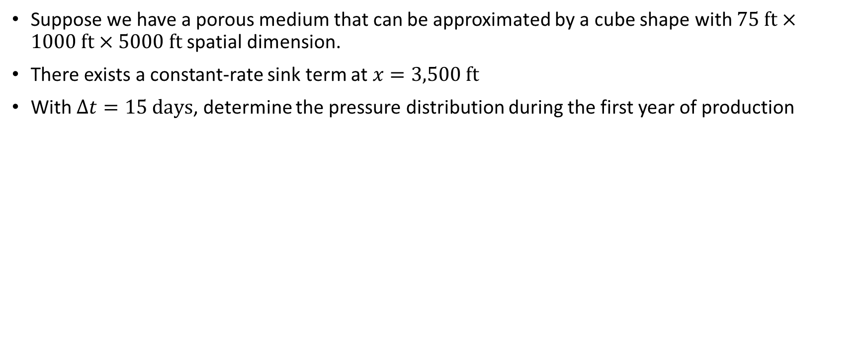

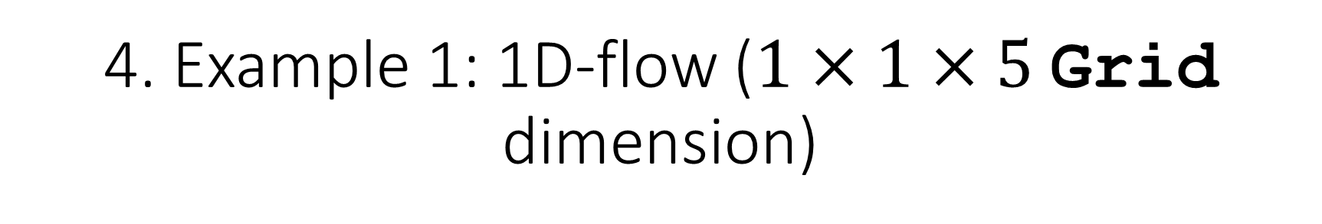


4. Example 1: 1D-flow ($1×1×5$ Grid dimension)
Suppose we have a porous medium that can be approximated by a cube shape with $75 ft×1000 ft×5000 ft$ spatial dimension.
There exists a constant-rate sink term at $x=3,500 ft$
With $Δt=15 days$, determine the pressure distribution during the first year of production
$$ρ_{l}=62\frac{lb_{m}}{ft^{3}}$$
$$c_{l}=3.5×{10}^{−6} psi^{−1}$$
$$k_{x}=15 mD$$
$$φ=0.18$$
$$μ_{l}=10 cP$$
$$P\left(x,0\right)=6000 psi$$
$$q_{sc}=−150\frac{BBL}{day}$$
1000 ft
1000 ft
75 ft
• 0
• 1
• 2
• 3
• 4
$$\frac{∂P}{∂x}=0$$
$$\frac{∂P}{∂x}=0$$

Slide 29
4. Example 1: 1D-flow ($1×1×5$ Grid dimension)

Slide 30
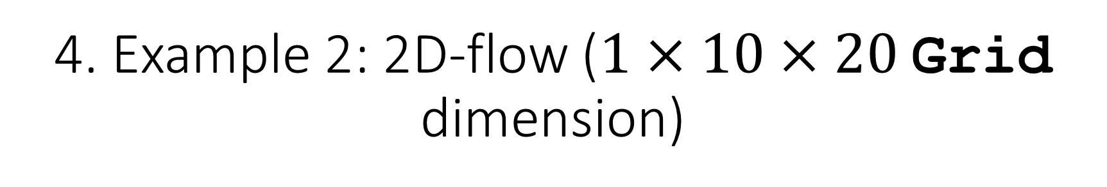
4. Example 2: 2D-flow ($1×10×20$ Grid dimension)
For this problem, we use the same specifications as Example 1. We approximate the location of the sink term at grid coordinate (0, 4, 13). The 3D visualization of pressure distribution by the end of the year is given by Fig. 6.

Slide 31
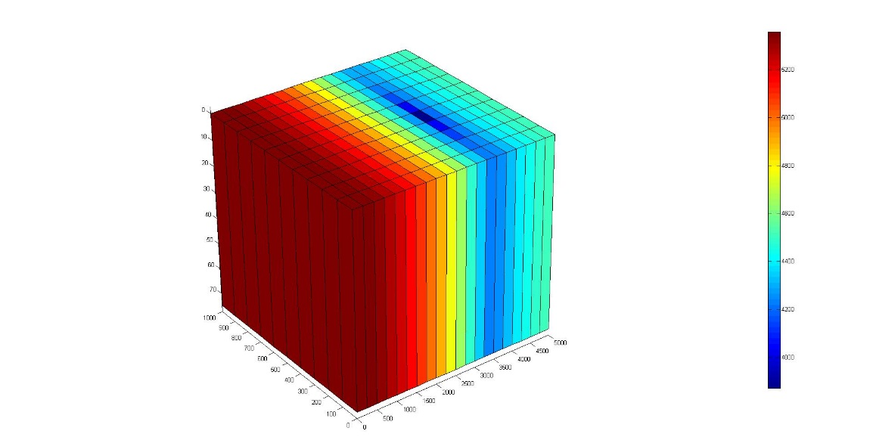

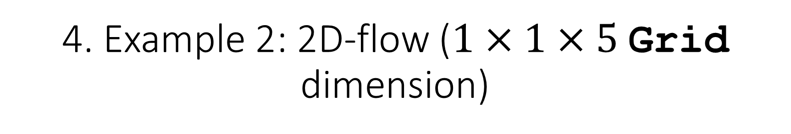
4. Example 2: 2D-flow ($1×1×5$ Grid dimension)
$$q_{sc}=−150\frac{BBL}{day}$$

Slide 32
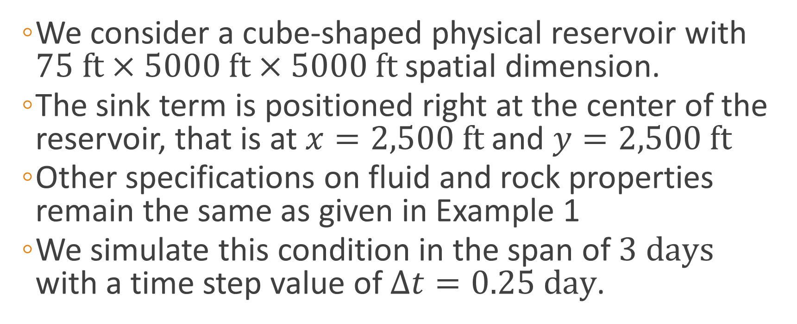
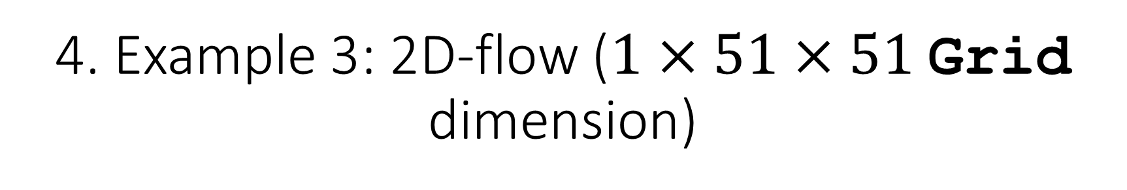
4. Example 3: 2D-flow ($1×51×51$ Grid dimension)
We consider a cube-shaped physical reservoir with $75 ft×5000 ft×5000 ft$ spatial dimension.
The sink term is positioned right at the center of the reservoir, that is at $x=2,500 ft$ and $y=2,500 ft$
Other specifications on fluid and rock properties remain the same as given in Example 1
We simulate this condition in the span of $3 days$ with a time step value of $Δt=0.25 day$.

Slide 33
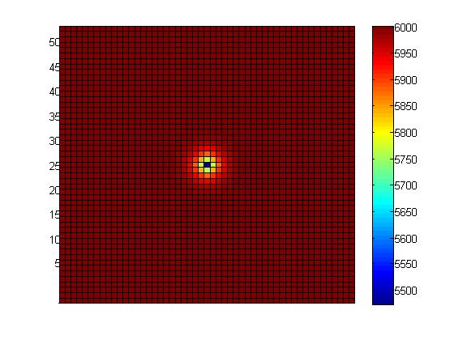
4. Example 3: 2D-flow ($1×51×51$ Grid dimension)
Pressure distribution at day 3

Slide 34
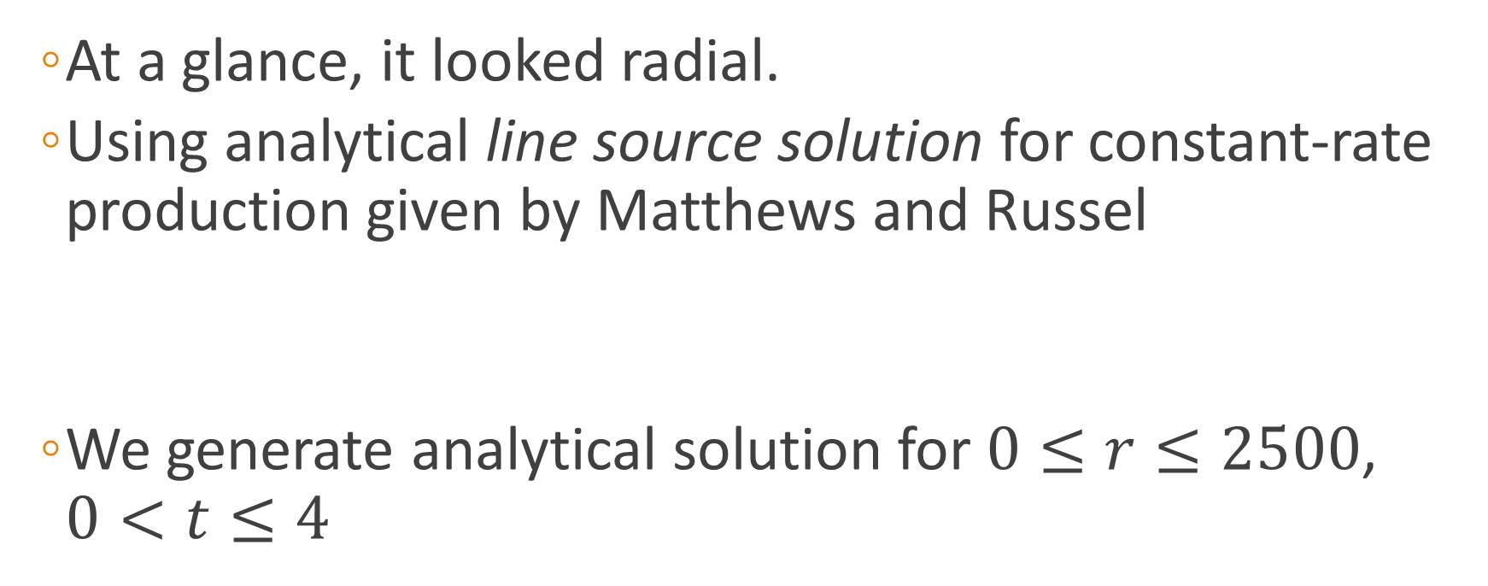
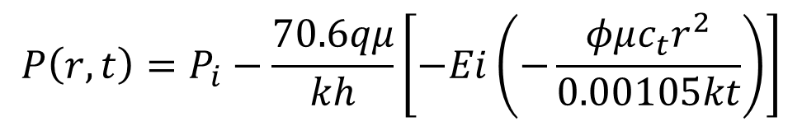
4. Example 3: 2D-flow ($1×51×51$ Grid dimension)
At a glance, it looked radial.
Using analytical line source solution for constant-rate production given by Matthews and Russel
We generate analytical solution for $0≤r≤2500$, $0<t≤4$
$$P\left(r,t\right)=P_{i}−\frac{70.6qμ}{kh}\left[−Ei\left(−\frac{φμc_{t}r^{2}}{0.00105kt}\right)\right]$$

Slide 35
4. Example 3: 2D-flow ($1×51×51$ Grid dimension)

Slide 36
4. Example 3: 2D-flow ($1×51×51$ Grid dimension)
The results obtained using the simulator seems to follow the same trend as the analytical solution.
But why not accurate enough? Possible reasons:
We have not implemented a well model (sink/source term is not a well yet)
Line-source solution assumes that the wellbore’s radius is infinitesimal
Numerical solution can never be as accurate as analytical solution

Slide 37
5. Concluding Remark
This paper presented a detailed implementation of building an implicit, single-phase, slightly compressible, black-oil fluid reservoir simulator using finite-difference approach in the form of Python code. One can revisit the code for study purpose and may extend or add new features.

Slide 38
6. Recommendations
The simulator could include a well model (van Poollen et. al.’s, Peaceman’s). So one can specify a pressure-specified or rate-specified well.
Fluid model may be extended to include highly-compressible fluid (gas).
One can also update the code further to include features like active/inactive gridblocks to approximate various geometries of an actual physical reservoir

Slide 39
Thank you

Slide 40
7. References
C. S. Matthews and D. G. Russell. 1967. Pressure Buildup and Flow Tests in Wells, Monograph Vol. 1. Society of Petroleum Engineers of AIME. Dallas, TX: Millet the Printer.
Ertekin, T., Abou-Kassem, J. H., and King, G. R. 2001. Basic Applied Reservoir Simulation. Richardson, Texas: Society of Petroleum Engineers, Inc.
Lie, K.-A. 2014. An Introduction to Reservoir Simulation Using MATLAB. Oslo, Norway: SINTEF ICT, Department of Applied Mathematics.
Wyckoff, R. D., Botset, H. G, Muskat, M., and Reed, D. W. 1934. Measurement of Permeability of Porous Media. AAPG Bull., 18, No. 2, p. 161.
Muskat, M. 1937. The Flow of Homogeneous Fluids through Porous Media. McGraw-Hill, Inc.

